Slide 1
Project: Detect Zombie Companies
Goal
Identify inactive companies but are labeled as active in the dataset
Dataset
35288 VC-backed companies
'prediction', 'InActive', 'LastFundingDate', 'LastFundingNo', 'TotalFunding', 'LastFundingAmount', 'CompanyName', 'Website', 'Description', 'CompanyOwnership', 'Industry Level 1', 'City', 'Country', 'FoundationYear'
Approach
Manually inspect 200 companies with highest predicted probability of default
Develop rules according to the characteristics
Validate by manually inspecting the set of predicted zombie companies

Slide 2
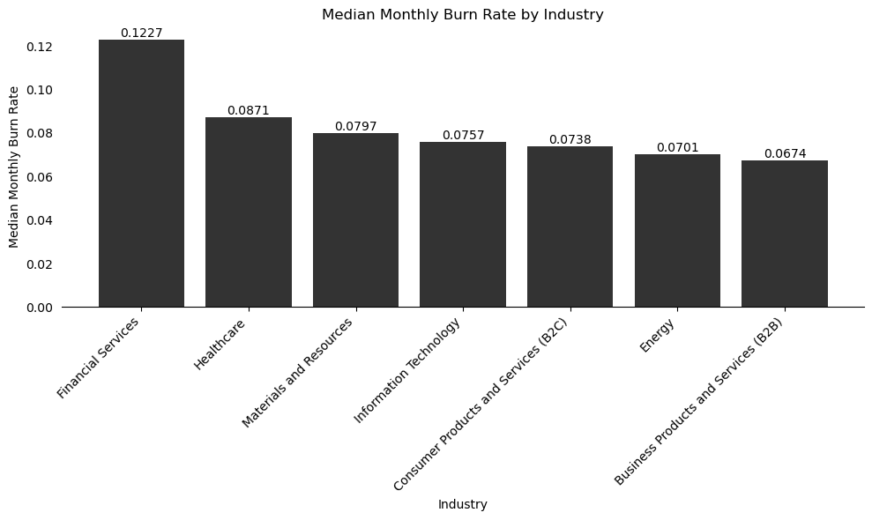
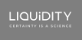
Project: Detect Zombie Companies
(Total Funding - Last Funding Amount)
Monthly Burn Rate =
Last Funding Date - Foundation Year
Company Ownership
Last Funding Date
Existing Features
Monthly Burn Rate

Slide 3
Project: Detect Zombie Companies
35288 VC-Backed Companies
Company Ownership
32660 Active
2628 InActive
Last Funding Date
Existing Features
26893 Financial Backing
5767: IPO, M&A
Monthly Burn Rate
3989 Negative Remaining Cash
22904 Positive Remaining Cash

Slide 4
Project: Detect Zombie Companies
3989 Negative Remaining Cash
Google Trends Search
2047 < industry median GG search
1942 > industry median GG search
Web Domain Activeness
External Features
1589 Active Website
458 Inactive Website
Cross-check with Crunchbase
(Acquisition status, Operating Status, Website monthly Visits, News)
848 with active status but no news in the last 2 years
741 has activities on Crunchbase

Slide 5
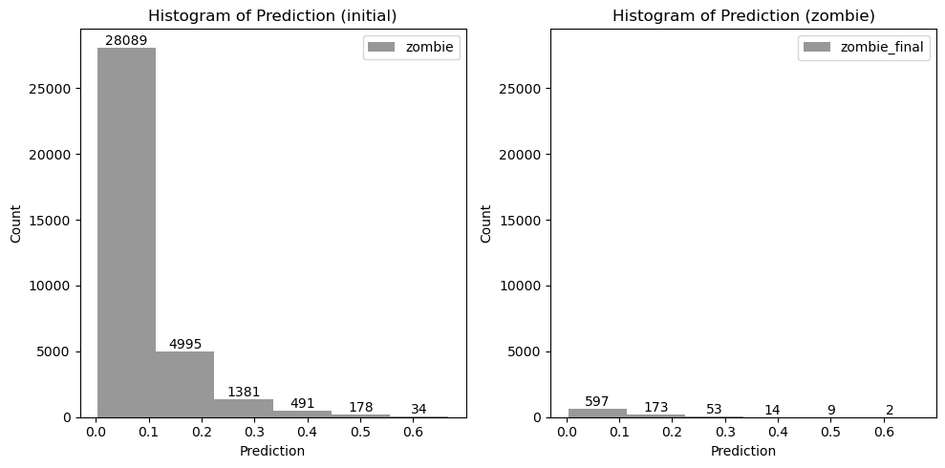
Project: Detect Zombie Companies

Slide 6
Project: Detect Zombie Companies
Next Step
1
Validate by checking LinkedIn of the zombie companies set
If the founders terminate their position at the companies
If the companies LinkedIn have any posts
2
Check the tax status of these companies

